Slide 1
TFT Rotations – ILI9341 (Micro USB) – Lovyan GFX
Panel_ILI9341 - DFUNCTR 0x08,0xC2,0x27
width 240
height 320
0
1
2
3
4
5
6
7
Title
Title
MX
MY
MV
Title
Title
 | MV | MX | MY
0
1 | MV | MX
2 |  | MX | MY
3 | MV |  | MY
4 |  |  | MY
5 | MV
6 |  | MX
7 | MV | MX | MY
Title
Title
Title
Title
https://github.com/lovyan03/LovyanGFX/blob/master/src/lgfx/v1/panel/Panel_LCD.hpp

Slide 2
TFT Rotations – ILI9341 (Micro USB) – Lovyan GFX
Panel_ILI9341_2 - DFUNCTR 0x08,0x82,0x27
width 240
height 320
0
1
2
3
4
5
6
7
Title
Title
MX
MY
MV
Title
Title
 | MV | MX | MY
0
1 | MV | MX
2 |  | MX | MY
3 | MV |  | MY
4 |  |  | MY
5 | MV
6 |  | MX
7 | MV | MX | MY
Title
Title
Title
Title
https://github.com/lovyan03/LovyanGFX/blob/master/src/lgfx/v1/panel/Panel_LCD.hpp

Slide 3
TFT Rotations – ILI9341 (Micro USB) – TFT_eSPI
width 240
height 320
0
1
2
3
4
5
6
7
Title
Title
MV
MX
MY
Title
Title
 | MV | MX | MY
0 |  | MX
1 | MV
2 |  |  | MY
3 | MV | MX | MY
4 |  | MX | MY
5 | MV | MX
6
7 | MV |  | MY
Title
Title
Title
Title
https://github.com/Bodmer/TFT_eSPI/blob/master/TFT_Drivers/ILI9341_Rotation.h

Slide 4
TFT Rotations – ST7789 (2 USB) – Lovyan GFX
width 240
height 320
0
1
2
3
4
5
6
7
Title
Title
MV
MX
MY
Title
Title
 | MV | MX | MY
0
1 | MV | MX
2 |  | MX | MY
3 | MV |  | MY
4 |  |  | MY
5 | MV
6 |  | MX
7 | MV | MX | MY
Title
Title
Title
Title
https://github.com/lovyan03/LovyanGFX/blob/master/src/lgfx/v1/panel/Panel_LCD.hpp

Slide 5
TFT Rotations – ST7789 (2 USB) – TFT_eSPI
setRotation()
width 240
height 320
0
1
2
3
Title
MV
MX
MY
Title
 | MV | MX | MY
0
1 | MV | MX
2 |  | MX | MY
3 | MV |  | MY
Title
Title
https://github.com/Bodmer/TFT_eSPI/blob/master/TFT_Drivers/ST7789_Rotation.h

Slide 6
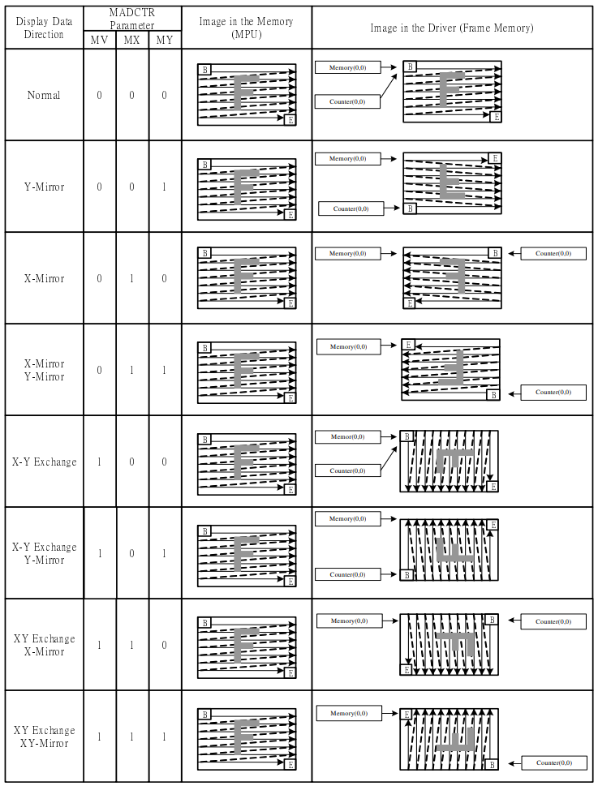

Slide 7
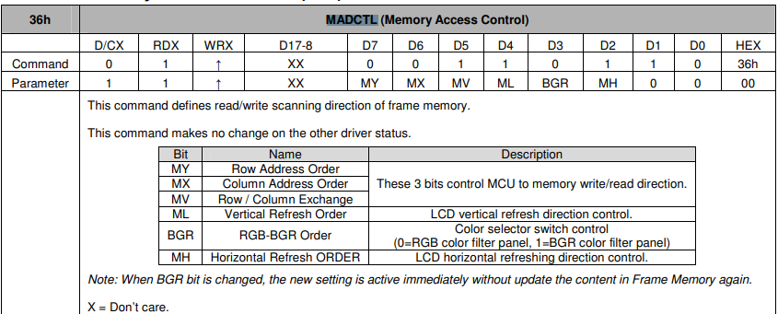
MY | MX | MV | ML | BGR | MH | 0 | 0
https://github.com/lovyan03/LovyanGFX/blob/master/src/lgfx/v1/panel/Panel_LCD.cpp

